Slide 1

2.5 Iterative deepening depth-first Search
The iterative deepening algorithm is a combination of DFS and BFS algorithms. This search algorithm finds out the best depth limit and does it by gradually increasing the limit until a goal is found.
This algorithm performs depth-first search up to a certain "depth limit", and it keeps increasing the depth limit after each iteration until the goal node is found.
This Search algorithm combines the benefits of Breadth-first search's fast search and depth-first search's memory efficiency.
The iterative search algorithm is useful uninformed search when search space is large, and depth of goal node is unknown.

Slide 2
Advantages/Disadvantages
Advantages:
It combines the benefits of BFS and DFS search algorithm in terms of fast search and memory efficiency.
Disadvantages:
The main drawback of IDDFS is that it repeats all the work of the previous phase.

Slide 3
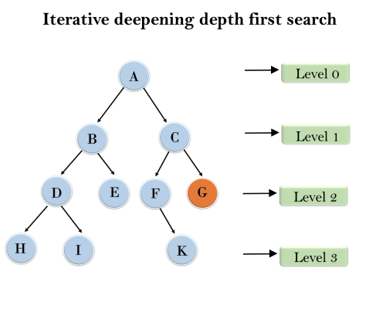
Example
Example: Following tree structure is showing the iterative deepening depth-first search. IDDFS algorithm performs various iterations until it does not find the goal node. The iteration performed by the algorithm is given as:
1'st Iteration-----> A 2'nd Iteration----> A, B, C 3'rd Iteration------>A, B, D, E, C, F, G 4'th Iteration------>A, B, D, H, I, E, C, F, K, G In the fourth iteration, the algorithm will
find the goal node.

Slide 4
Properties
Completeness: This algorithm is complete is if the branching factor is finite.
Time Complexity: Let's suppose b is the branching factor and depth is d then the worst-case time complexity is O(b^{d}).
Space Complexity: The space complexity of IDDFS will be O(b^{d}).
Optimal: IDDFS algorithm is optimal if path cost is a non- decreasing function of the depth of the node.

Slide 5
CrypArithmetic Problem
Type of Constraint Satisfaction Problem.
Constraints :
No two letter have same value
Letters can have value between 0 – 9
S E N D
+ M O R E
M O N E Y

Slide 6
CrypArithmetic Problem
Extra letter always hold carryover i.e 1
S + M, if M = 1
S + M >=10
S = 9
E + 0(zero) = N
Case 1: If C2 is 0 (means no carry over) then E = N (Not possible)
Case 2: If carry over means C2 = 1, then
Let E = 5
E + 0 + C2 = N => 5 + 0 + 1 = 6
Means E = 5 & N = 6

Slide 7
CrypArithmetic Problem
3. N + R = E
6 + R = 5
Let R = 9
6 + 9 = 15, but 9 is already assigned to S
6 + R + C1 = 5
6 + 8 + 1 = 15,
It means R = 8

Slide 8
CrypArithmetic Problem
4. D + E = Y
D + 5 = Y
Since it is providing carry means, D>=5
So, option for D are 5,6,7,8,9. All digits except 7 are already assigned. So we assign 7 to D, therefore
7 + 5 = 12
Means D gets 7 and Y gets 2.

Slide 9
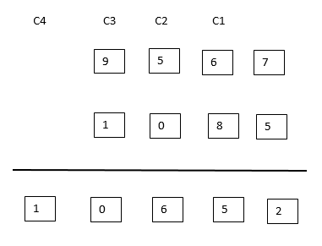
CrypArithmetic Problem

